Slide 1
ND0
PL

Slide 2
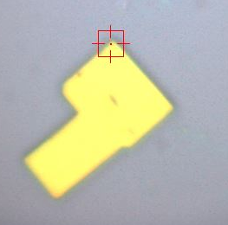
pt1
1
2
3
7
5
8
6
4
20µm

Slide 3
pt1
HW=60.891

Slide 4
5097.81839
4395.47418

Slide 5
pt2
1
2
3
7
5
8
6
4
20µm

Slide 6
pt2
HW=53.648

Slide 7
11610.43714
859.3067

Slide 8
pt3
1
2
3
7
5
8
6
4
20µm

Slide 9
pt3
HW=64.983

Slide 10
20843.29544
11552.85951

Slide 11
pt4
1
2
3
7
5
8
6
4
20µm

Slide 12
pt4
HW=51.39

Slide 13
9458.88658
19589.3124

Slide 14
pt5
1
2
3
7
5
8
6
4
20µm

Slide 15
pt5
HW=62.01

Slide 16
14550.71975
14612.19291

Slide 17
pt6
1
2
3
7
5
8
6
4
20µm

Slide 18
pt6
HW=64.243

Slide 19
5219.88903
9916.76097

Slide 20
pt7
1
2
3
7
5
8
6
4
20µm

Slide 21
pt7
HW=50.43

Slide 22
32596.59404
1141.72557

Slide 23
pt8
1
2
3
7
5
8
6
4
20µm

Slide 24
pt8
HW=59.26

Slide 25
13945.51109
15276.30144

